Slide 1

World Cup Fans System
Team: Jinlang He 001531339
Yuemei Chen 002954427
Ming Cheng 002925270

Slide 2


Table of contents
01
04
Introduction
Sequence Diagram
02
05
Model
contribution
03
06
Class Diagram
Run Demo

Slide 3


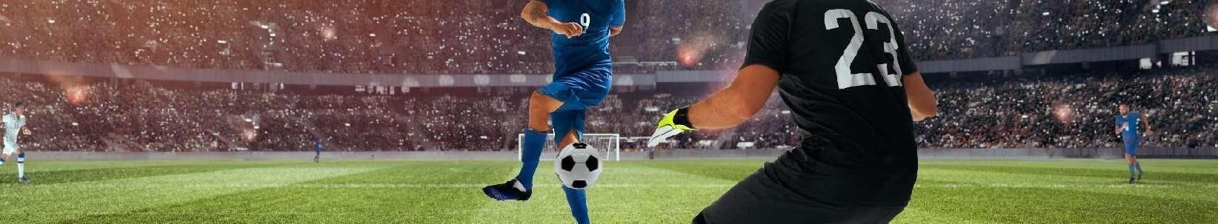
Introduction
This system is designed to provide service for soccer fans during the 2022 World Cup by arranging game-watching events.

Slide 4

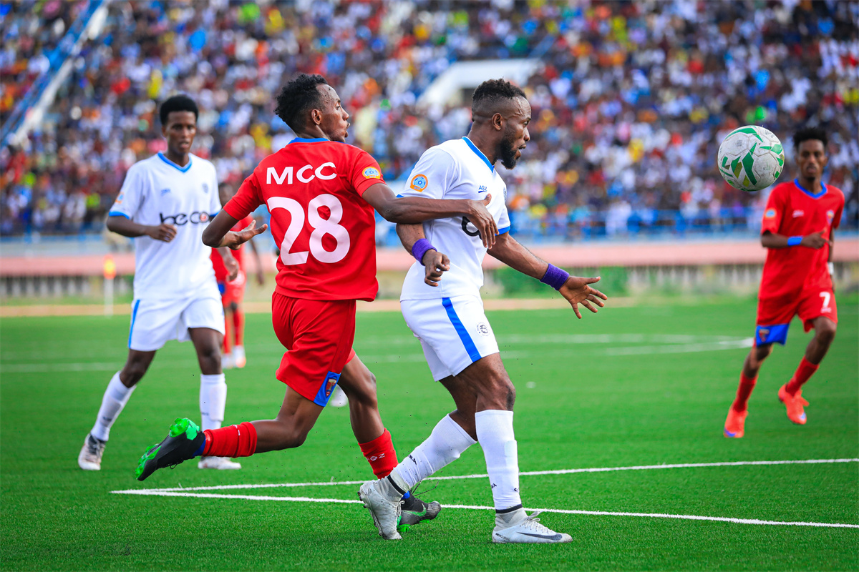

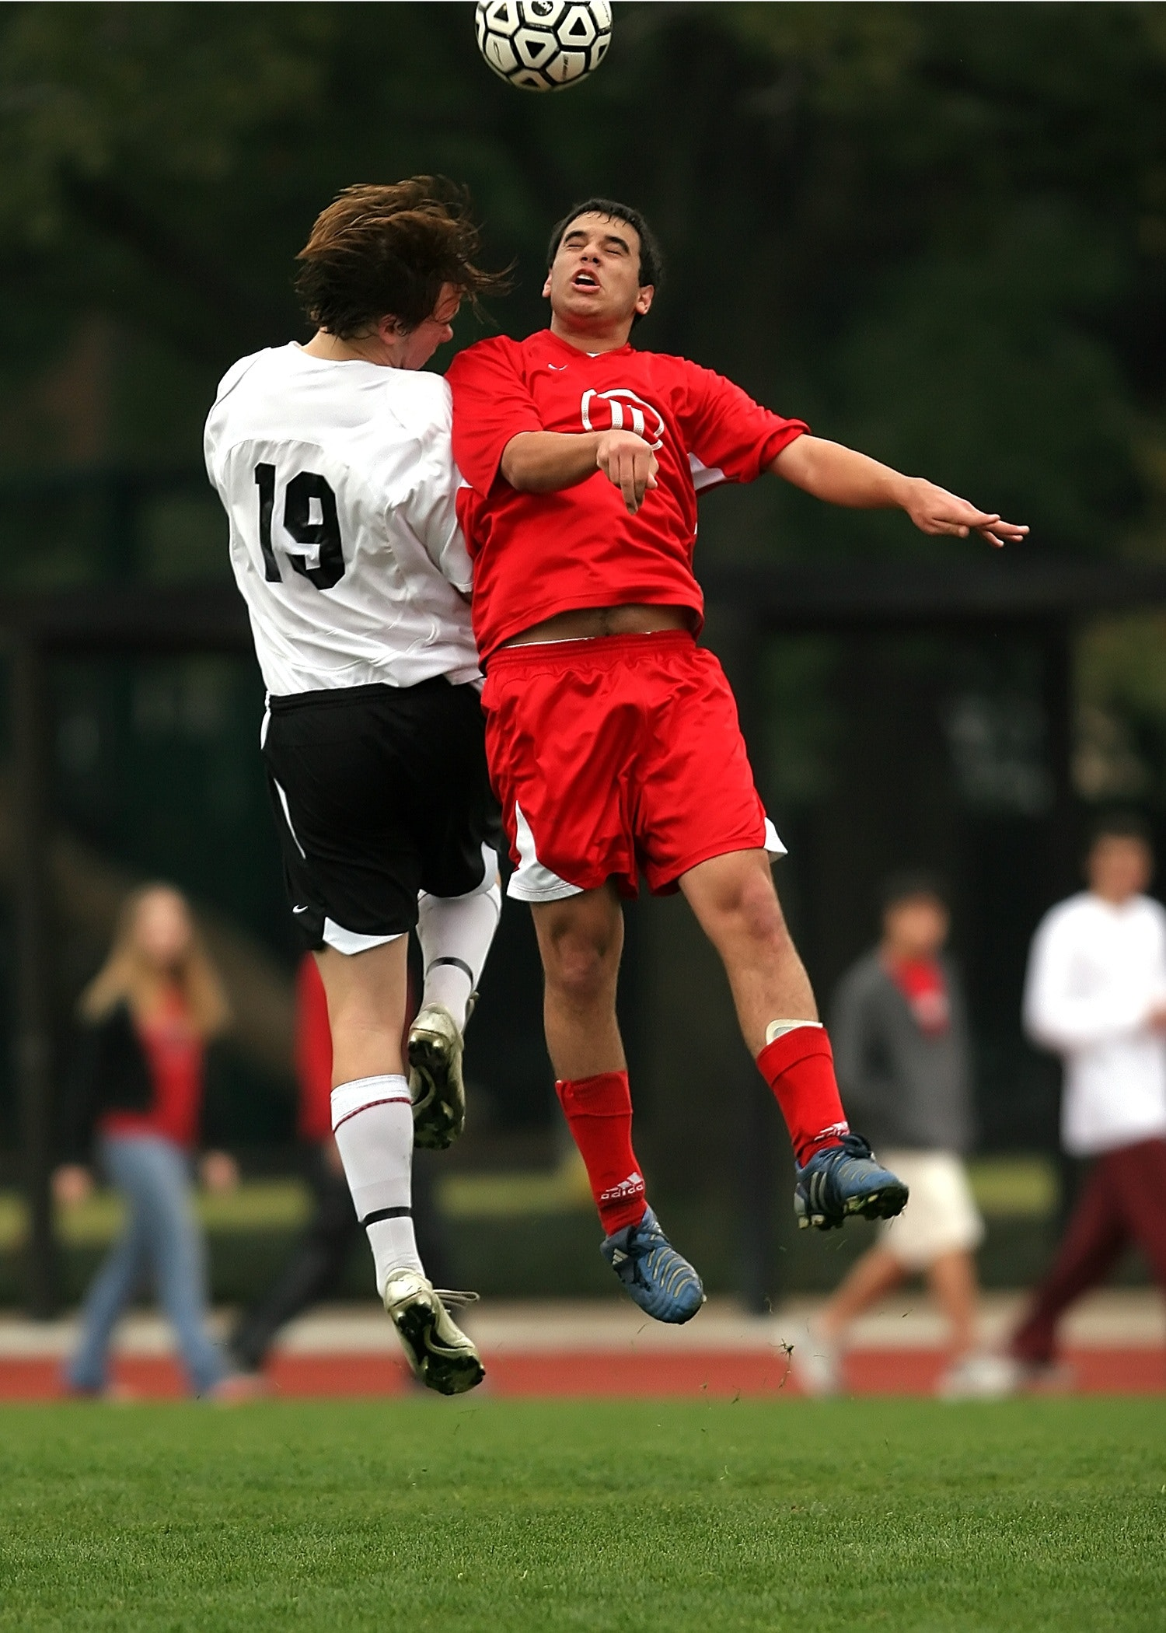
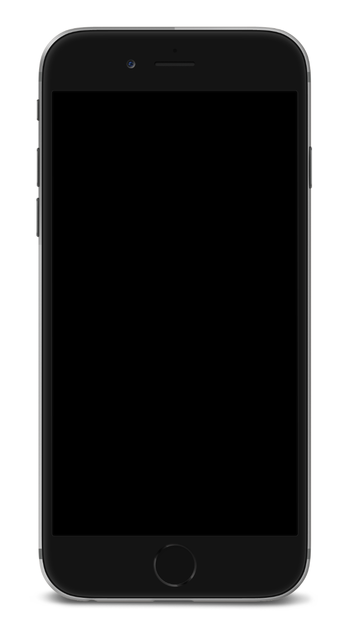
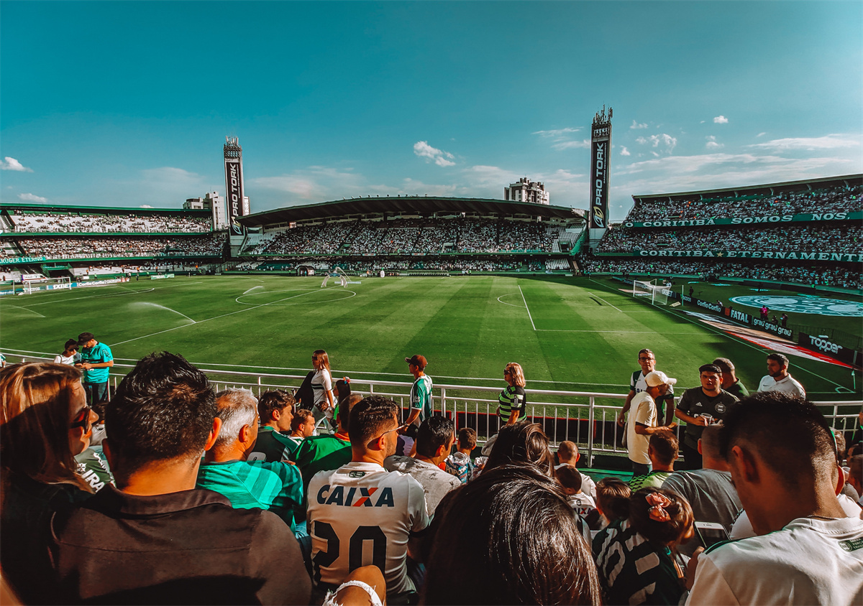
Our system consists of 4 Enterprises:
BarEnterprise
CheerAgency
WorldCupFansClub
Population

Slide 5
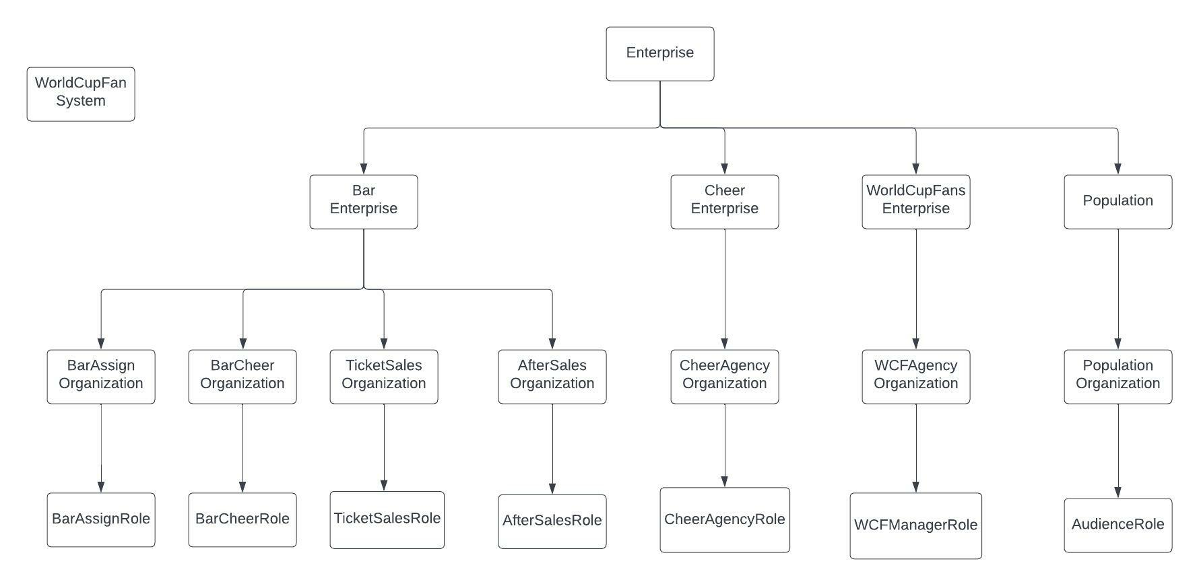
Model Explanation

Slide 6
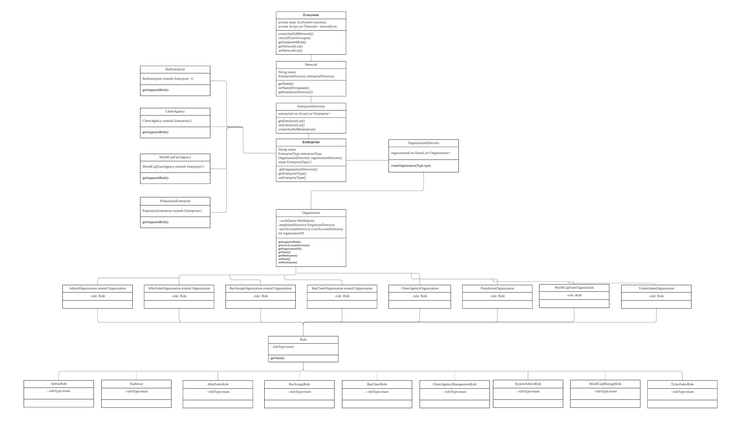
Class Diagram

Slide 7
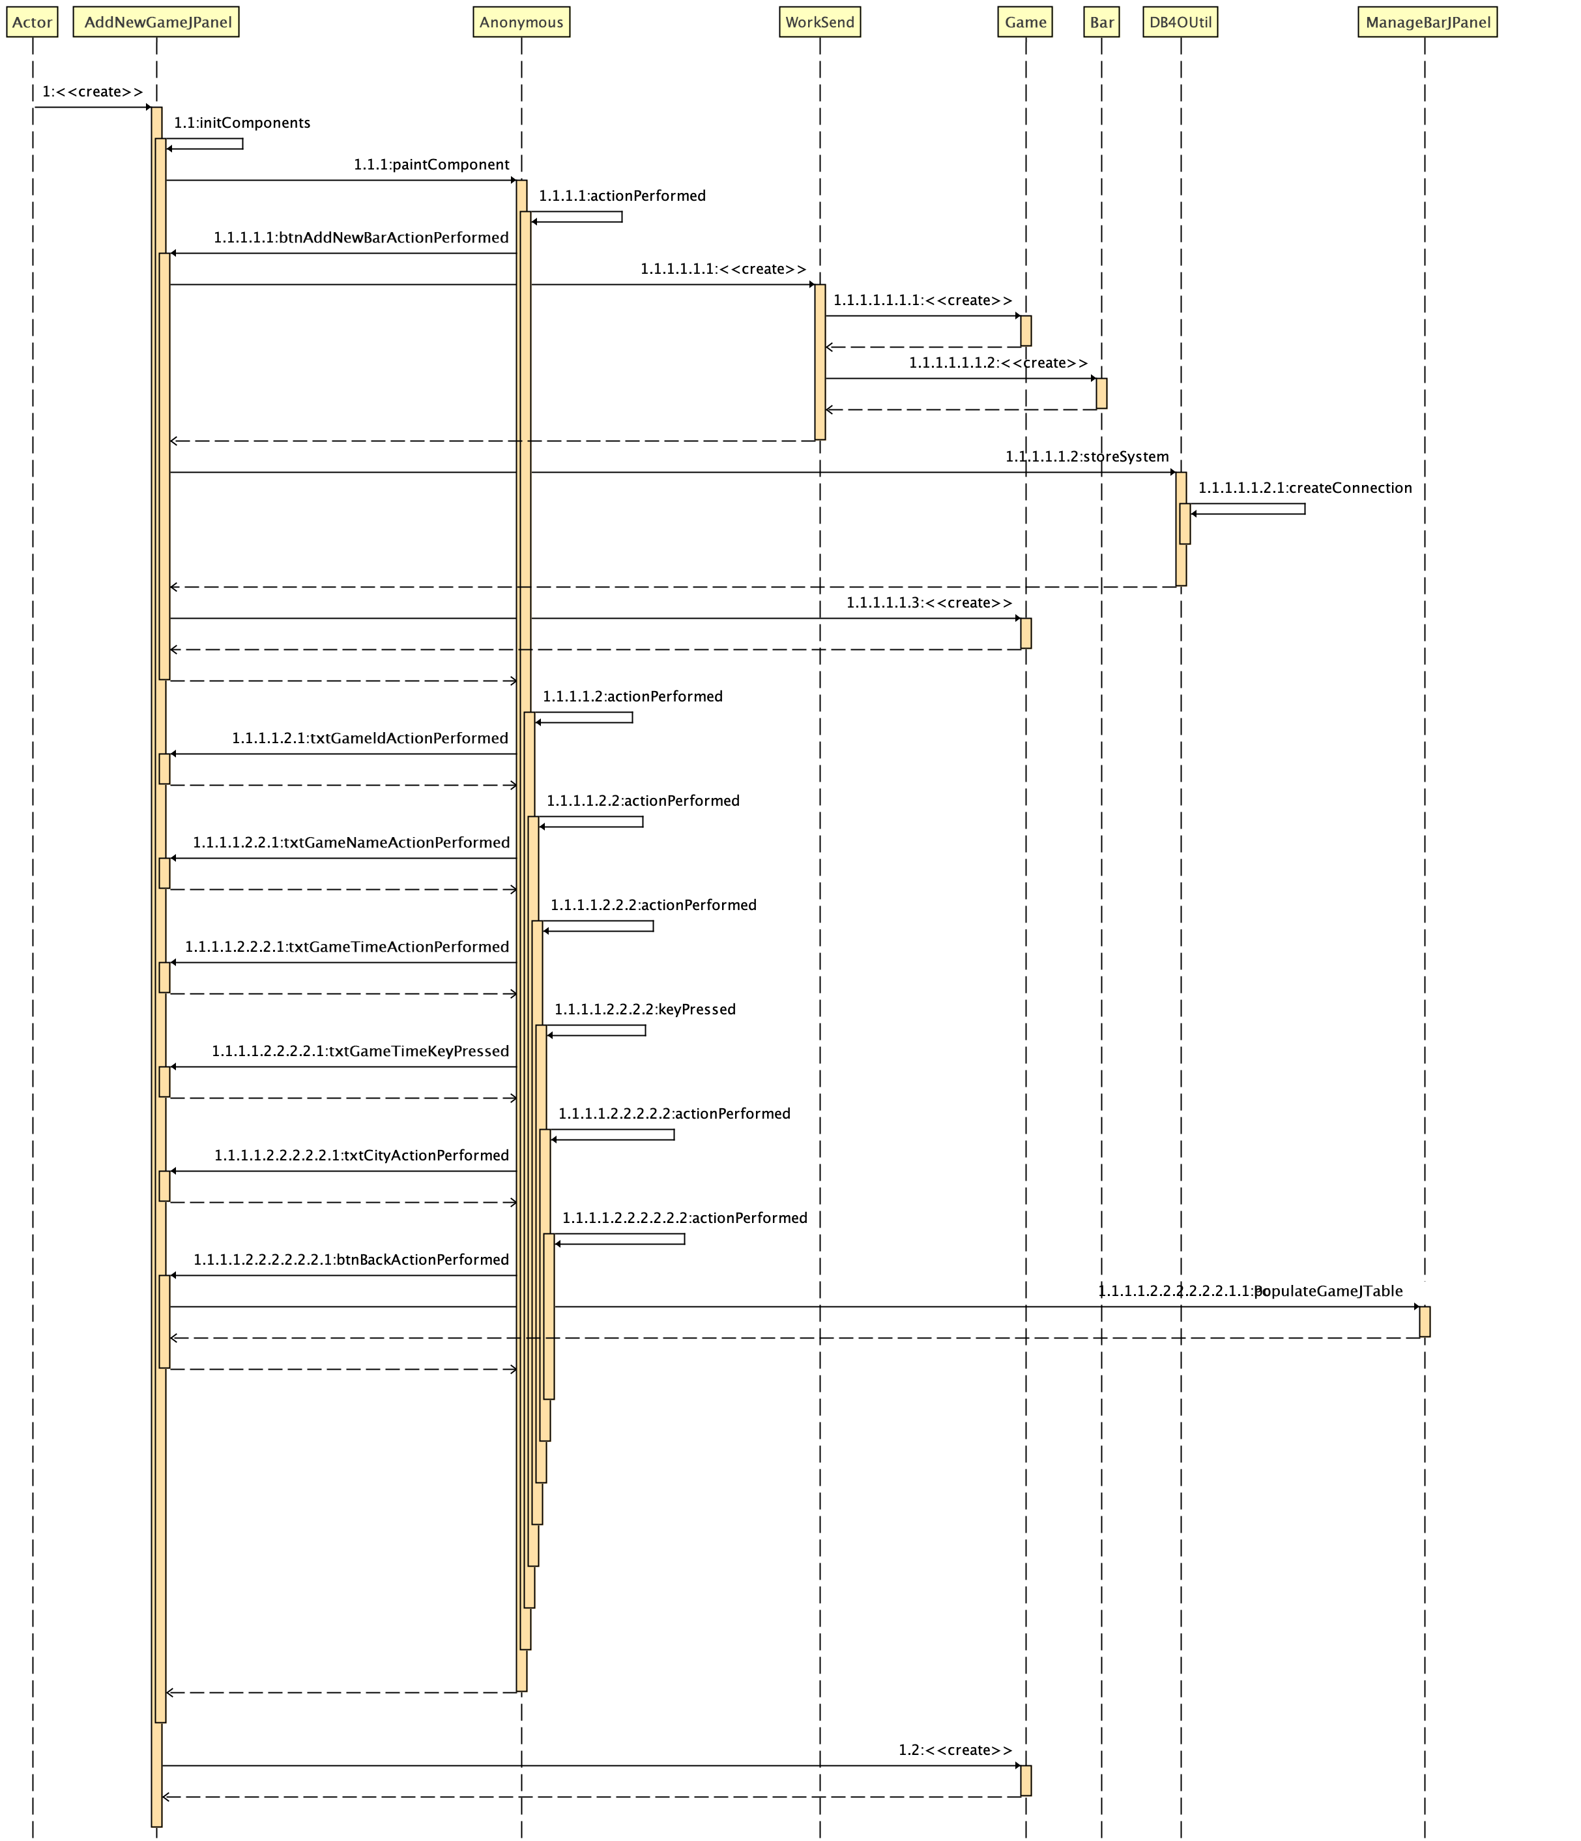
Sequence Diagram
Add New Game

Slide 8
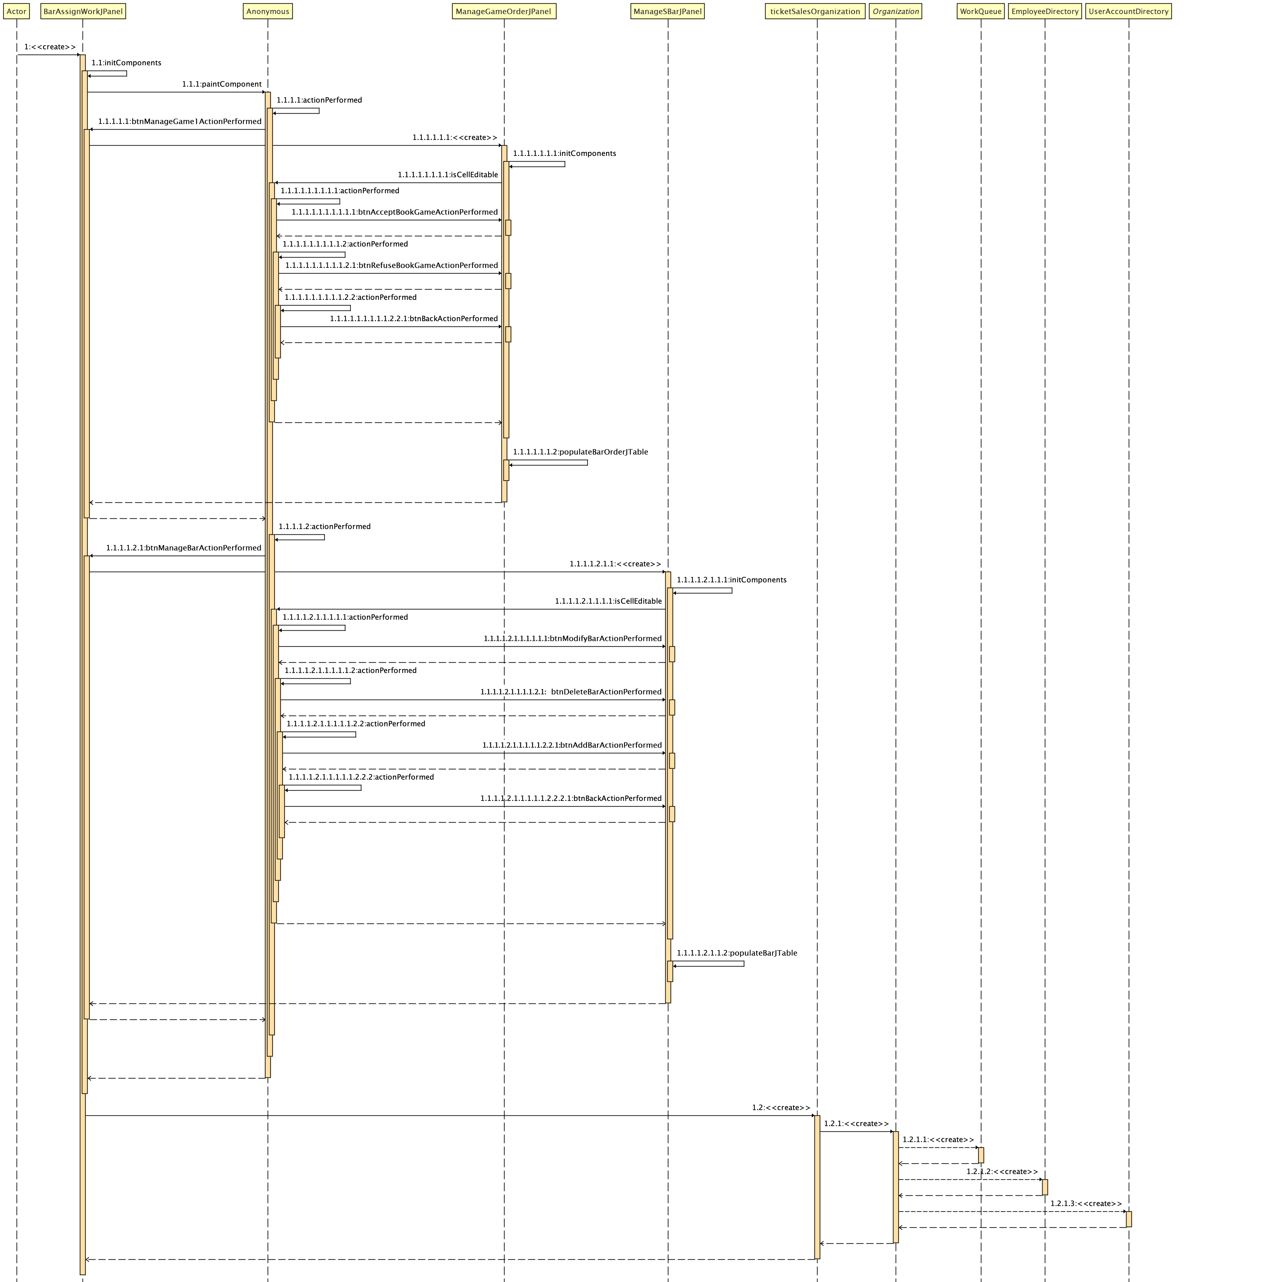
Sequence Diagram
BarAssignment

Slide 9
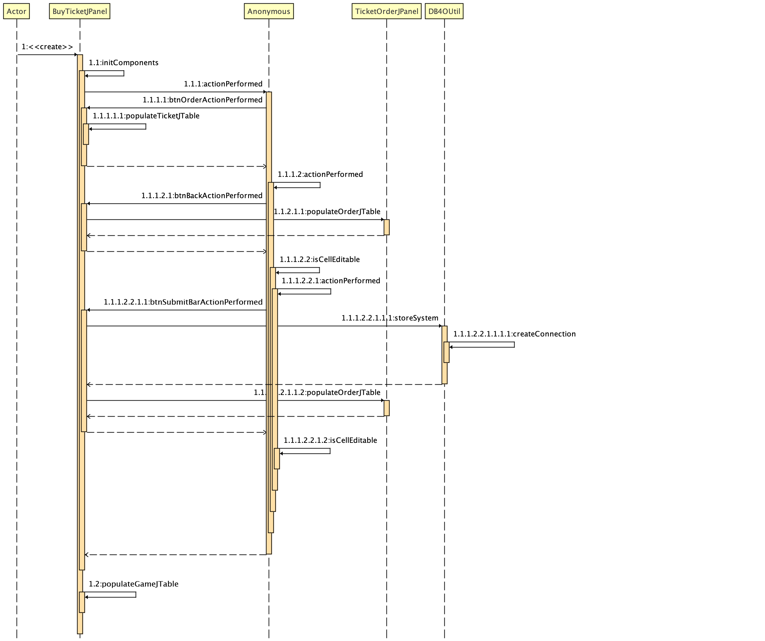
Sequence Diagram
BuyTicket

Slide 10

Contribution
Jinlang He:
Bar Enterprise,
BarAssignManagerRole,
TicketSaleRole&AfterSaleRole
Yuemei Chen:
SystemAdminstorRole, CheerAngencyEnterprise,
Ming Cheng:
WorldCupFansEnterprise,
WCFManager.

